Slide 1
CSCE 623 In Class Day 09
Synchronous session

Slide 2
Agenda
Key points Lecture on resampling and validation
Activity – Mid Course Topic Review

Slide 3
Key points
Rationale for Resampling
The Golden Rule (for partitioning observations into subsets)
Methods for validation set partitioning
Using validation data for decision-making

Slide 4
Rationale for Resampling
Tools that involve repeatedly drawing samples from a training set and refitting a model of interest on each sample in order to obtain more information about the fitted model
Model Assessment: estimate error rates on unseen data
Model Selection: select appropriate model hyperparameters (e.g. level of model flexibility)
Two key resampling methods:
Bootstrapping
Good for parameter estimation
we will cover bootstrapping as part of random forest ensemble models
Cross-Validation
used throughout ML for tuning and performance estimation
also explored in HW4

Slide 5
Golden Rule for observations
If you use an observation as part of your decision-making process, then you should NOT use it as part of a set of data you are using to report performance

Slide 6
Training v. Validation v. Test Data
TEST Data: Used for performance prediction only. It estimates performance of a model on unseen data. Sequester the test set before exploring the data
NON-TEST-SET DATA:
Training Data: Used to “fit” parameterized models (e.g. find coefficients/weights or as the data for non-parametric methods like KNN
Validation Data – 2 uses; Pick One:
Obtain an (average) estimate of a model’s performance quality from non-training data
Make selection decisions (e.g. pick the best k in KNN; select whether LDA or QDA model works best; feature selection)

Slide 7
Three options for validation set partitioning
Validation Set: split observations into training and validation subsets
K-fold Cross-Validation: split observations into multiple folds and reuse folds for training and validation
LOOCV: a specific version of K-fold CV where K = N
What are the Pros and Cons of each technique?

Slide 8
Three options for validation set partitioning
Validation Set: split observations into training and validation subsets
K-fold Cross-Validation: split observations into multiple folds and reuse folds for training and validation
LOOCV: a specific version of K-fold CV where K = N
What are the Pros and Cons of each technique?
Val set

Slide 9
Validation Use Case: Decisionmaking Select a hyperparameter in a model
Logistic Regression
KNN
Blue: Training Error
Black: 10-fold CV Error
Beige: Test Error
Blue: Training Error
Black: 10-fold CV Error
Beige: Test Error
Concept Check: How do we interpret the results of these graphs? What value polynomial should we choose?

Slide 10
Questions on CH5

Slide 11
Activity: Mid Course Topic Review

Slide 12
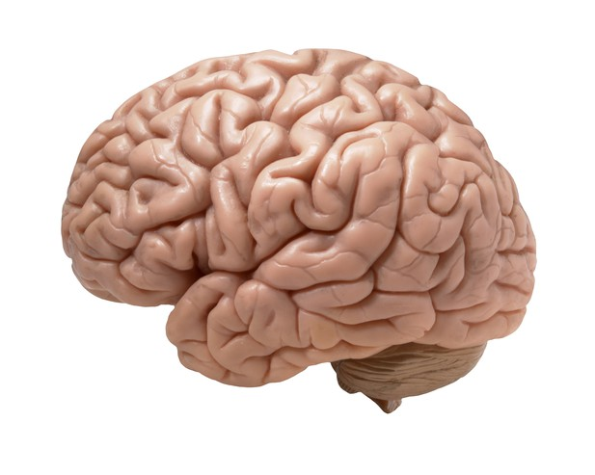
Special Temporal Instructions for the next activity (topic to be explained…)
You will have 5 minutes total to complete the next activity – in two phases
Phase 1 (At least One Minute): Identify at least one item in each category from memory only (don’t use book / notes / internet)
Phase 2 (after first minute): Whenever your memory is empty… Identify additional items using course content (book, teams, canvas, slides, HW)
Get as many ideas down from memory (L1 Cache) before switching to lookup (external sources)
After complete, we will share your items in the main discussion
On the next page are the instructions…
This Photo by Unknown Author is licensed under CC BY

Slide 13
Some topics of first half of the course…
DST & Forming a ML question
Data Exploration
Regression and Performance Measures
Classification and Performance Measures
Resampling and Decision-making with Validation Data
Use the worksheet on MS Teams (or download from Canvas)
5 Minute Individual Activity: Identify at least one important concept or thing you learned for each of these 5 topic areas shown above
At least the first minute: from memory only
after first minute: Lookup authorized if memory is empty!

Slide 14
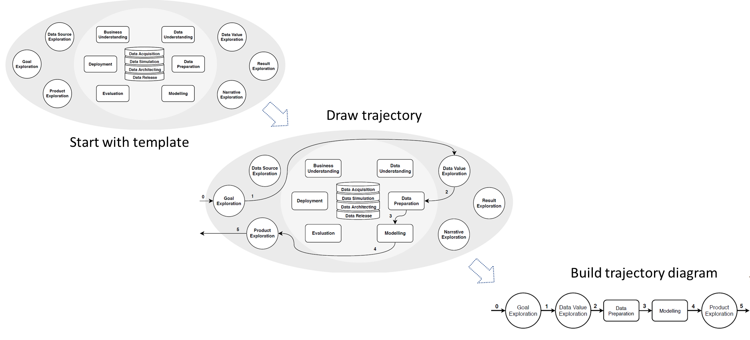
DST & Forming a ML Question (student answers)

Slide 15
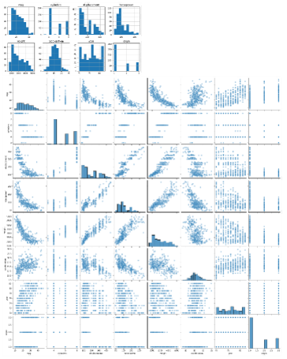
Data Exploration (student answers)

Slide 16
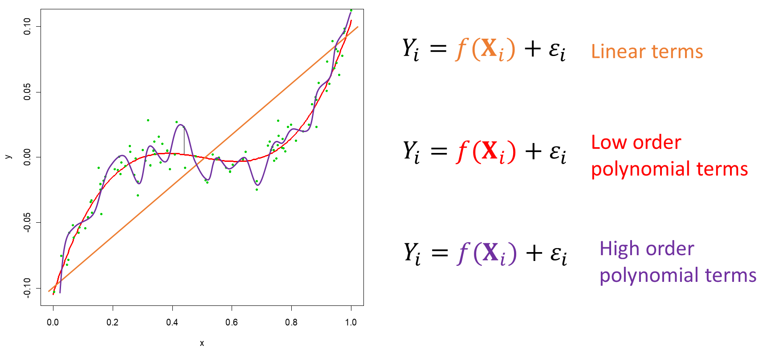
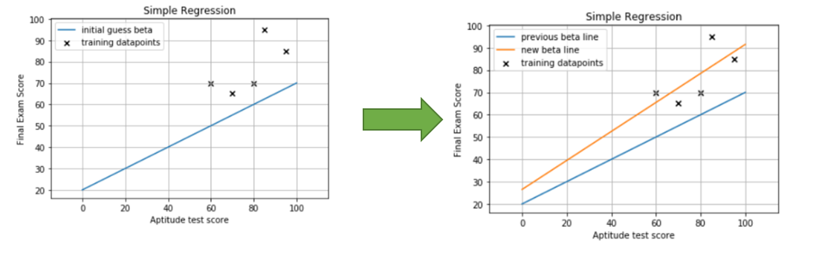
Regression and performance measures (student answers)

Slide 17
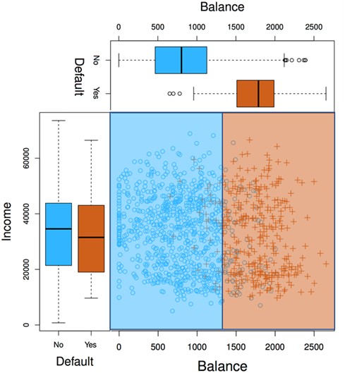
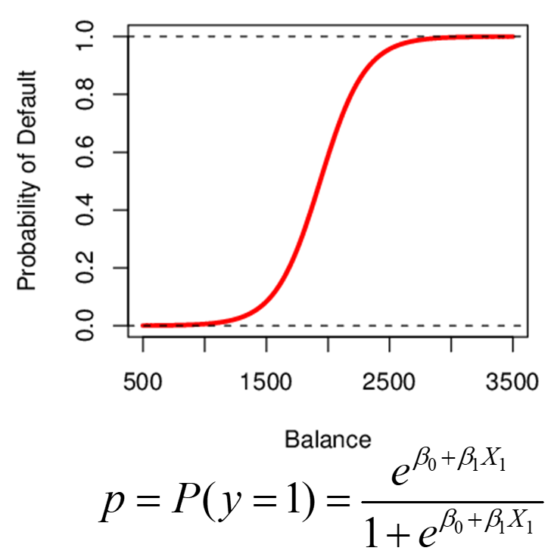
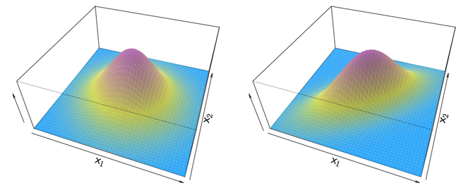
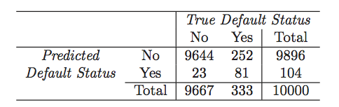
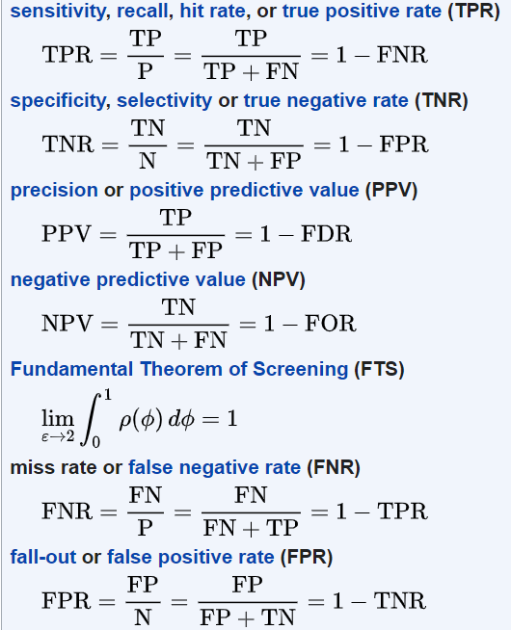
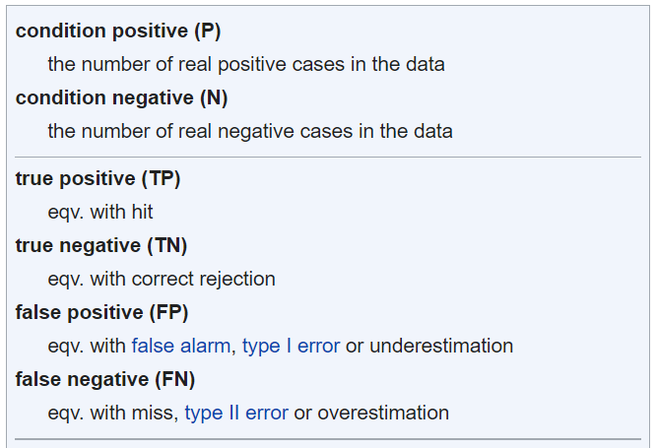
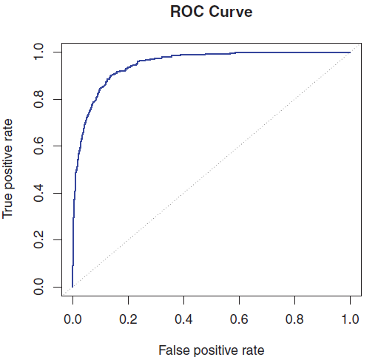
Classification and performance measures (student answers)

Slide 18
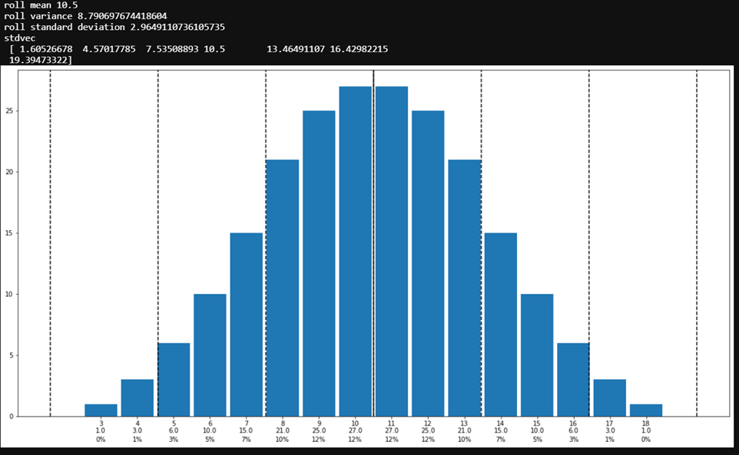
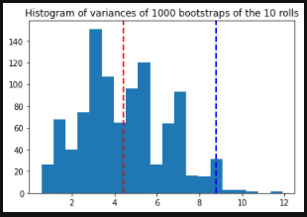
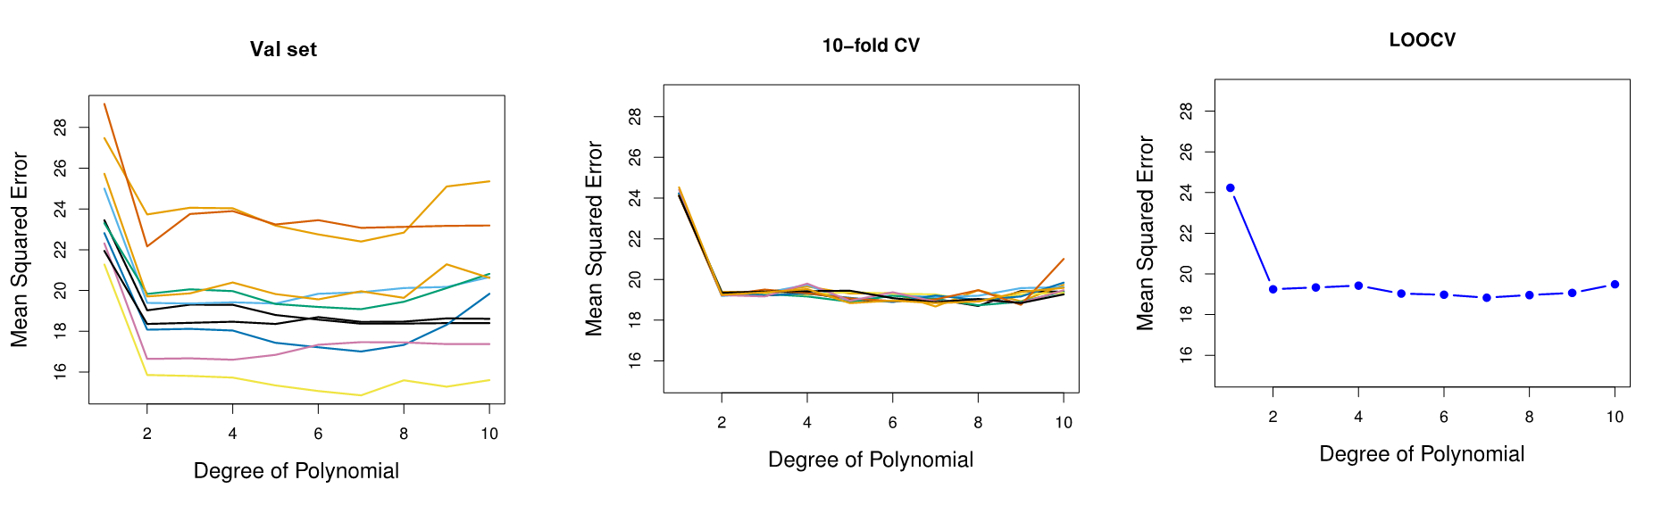
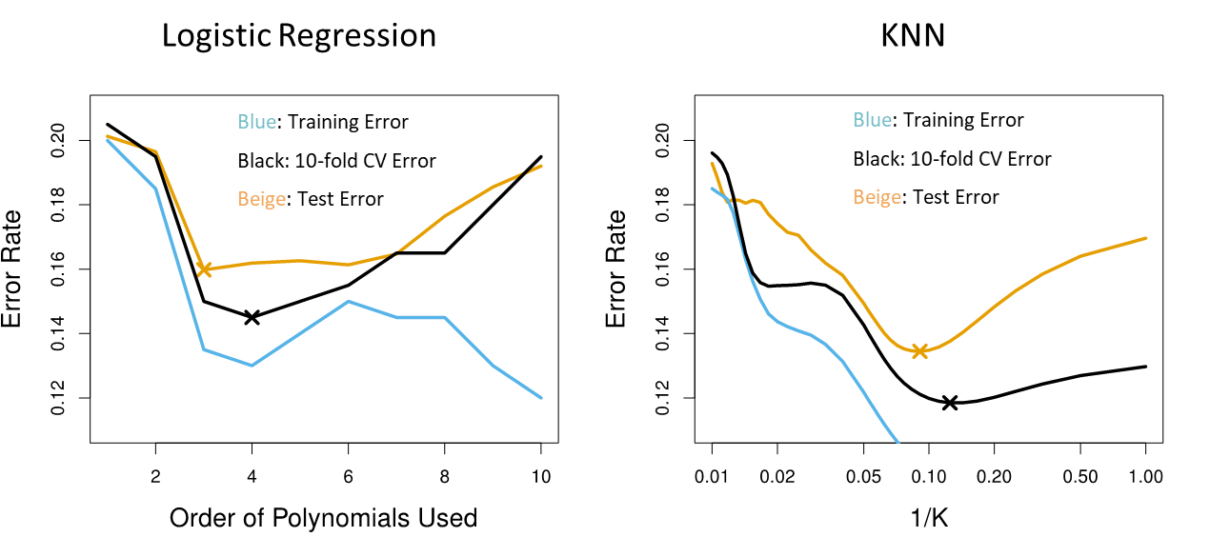
Resampling and Decision-making with validation data (student answers)

